Slide 1
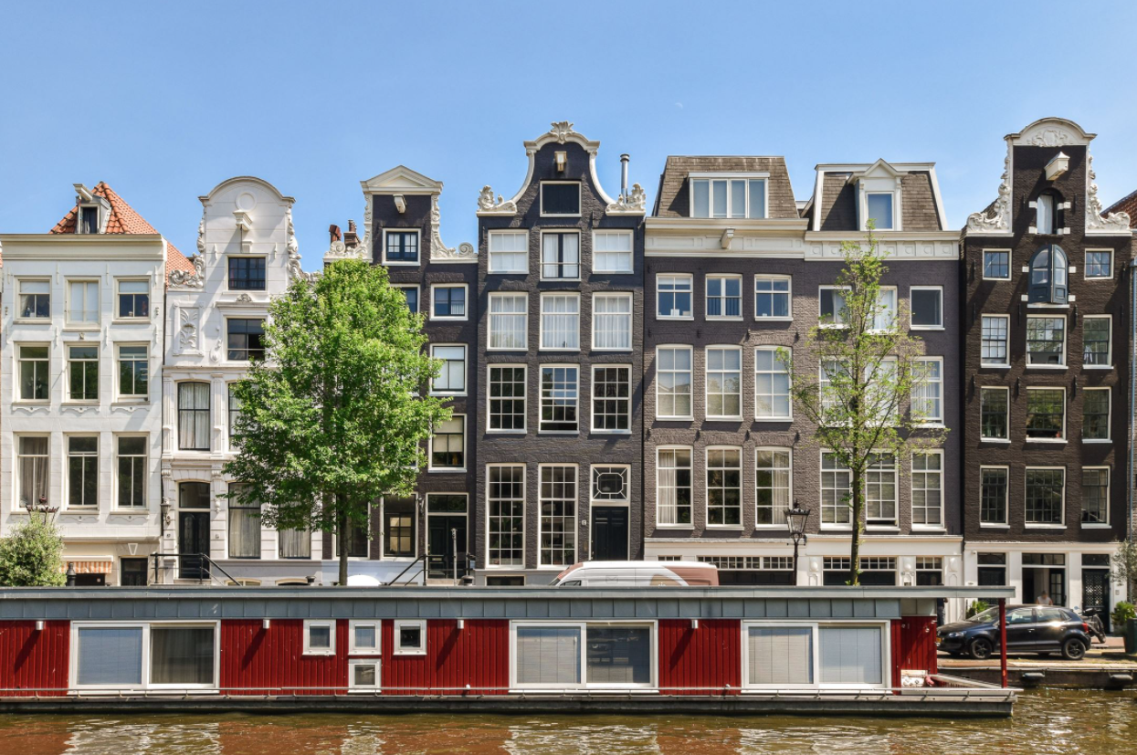
Amsterdam housing market
Final project
October 8, 2021
René van Schalkwyk
Notes:
Line spacing + Page numbers

Slide 2
Overview
01 Introduction
02 Data set
03 Key statistics
04 Interest insights
05 Model
06 Conclusion

Slide 3

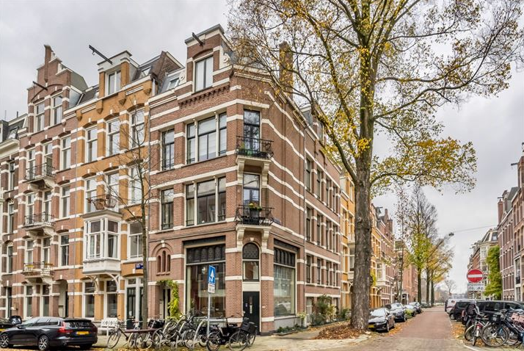
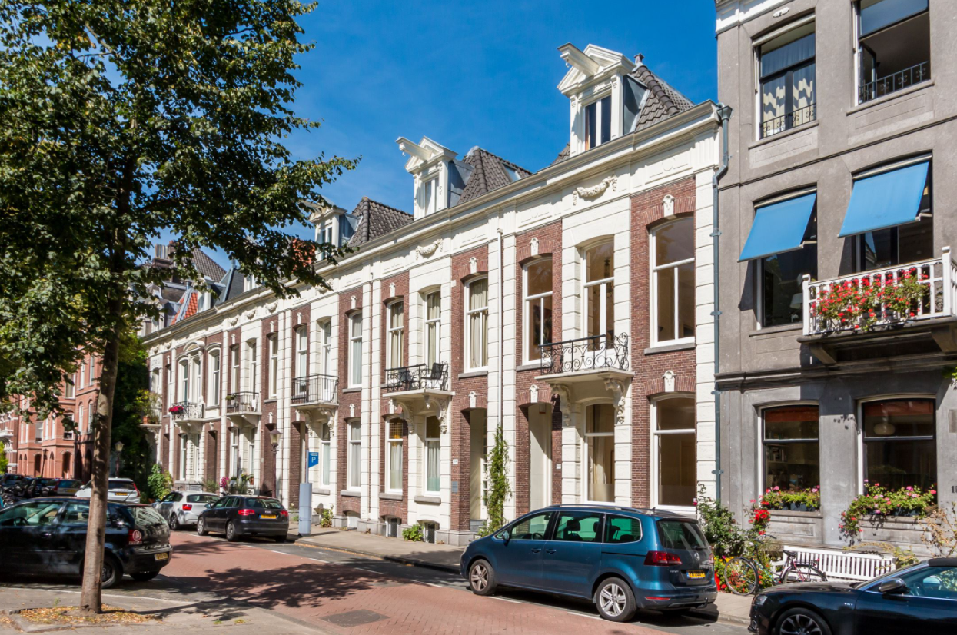
Introduction
01
House prices in Amsterdam has been increasing at a very fast pace
“The situation is crazy”, the chairman of the Dutch Association of Real Estate Agents (NVM) said in a recent statement, as he called for government intervention to stabilise the market.
Project looks at a subset of the Amsterdam sold apartments, also looking at the differences in the listed prices vs. actual selling prices
Created a model to predict selling prices for apartments in Amsterdam

Slide 4
Data set
02
Data set compiled from apartments sold during the period 2020/2021
Data collected via web scraping funda.nl (website where the complete Dutch housing offer through real estate agents can be found) using a combination of selenium and Beautiful Soup
Additionally selling prices were obtained from walterliving.com (website providing information on the Dutch housing market provided by various external sources)

Slide 5
Key statistics from the dataset
03
Avg. over bidding
9%
Number of rooms
4
Avg. selling price
EUR 512K
Avg.
listed price
EUR 475K
Avg. living area
76 m2
Apartments sold
(3862)
Avg.
listed period
20 days
Avg. selling price per m2
EUR 7K

Slide 6
Interesting insights
04

Slide 7
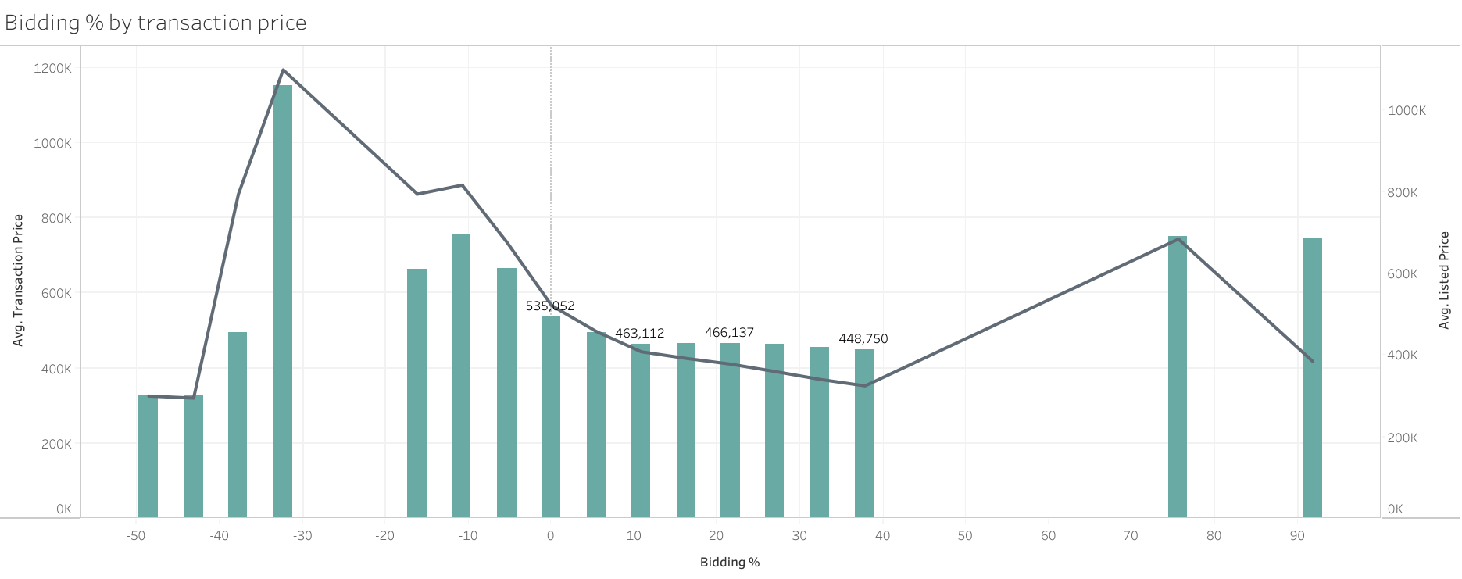
Over bidding percentage

Slide 8
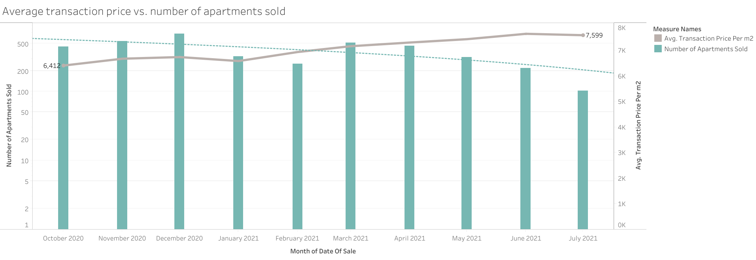
Average transaction price over time

Slide 9
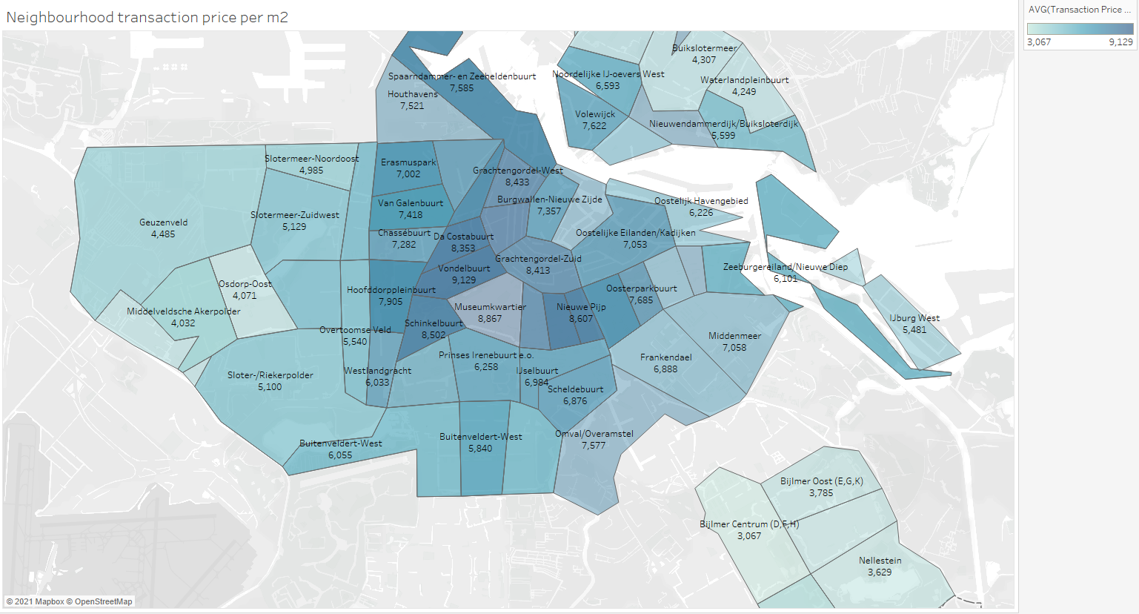
Neighbourhoods

Slide 10
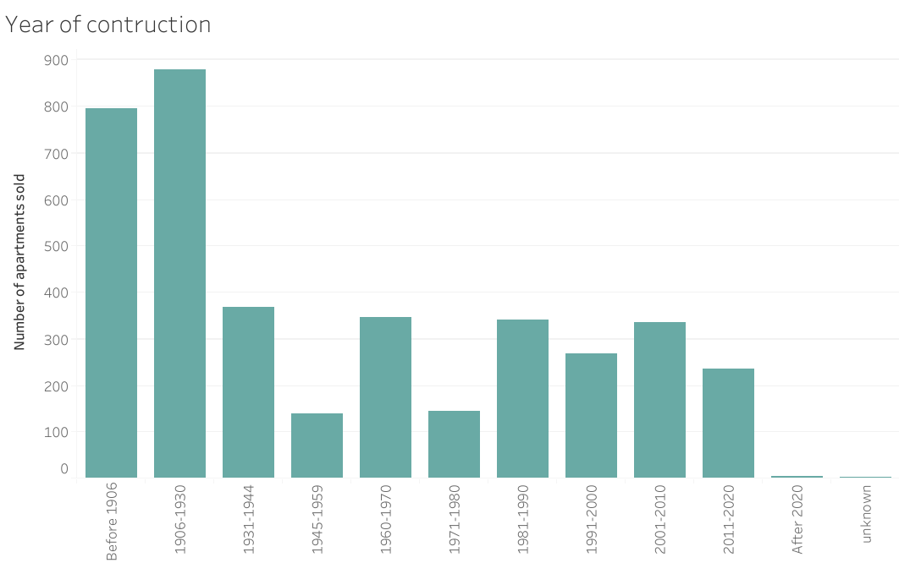
Year of construction

Slide 11
Model
05
Goal is to predict expected transaction price (i.e., selling price) for apartments in Amsterdam; ignoring the listed price
Data set used for the model consisted of 3862 apartments with various features (such as neighbourhood, living area, etc.). 80% was used to train the model
Fitted various regression models
The best performing models ; Random forest regressor (RFG) and Gradient Boosting Regressor (GBR) with the GBR the best performing
Scores | RFG | GBR
R2 | 0.80 | 0.87
RMSE | 107264 | 86366
NRMSE | 0.19 | 0.15

Slide 12
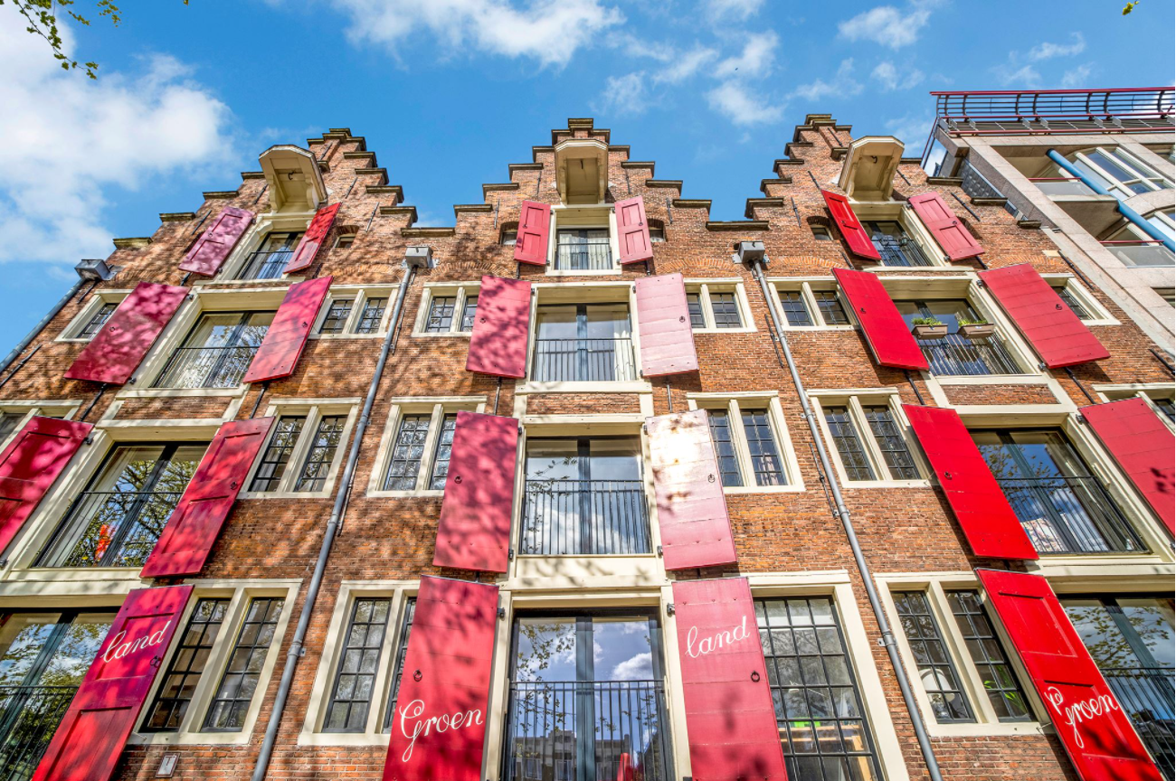

Conclusion
06
Knowing what to offer can give a competitive advantage.
Advice: not focus too much on the listed prices, especially looking at the under EUR460K price range
Offer a competitive price looking at the apartment and features; not using a general bidding mark-up

